Slide 1


Slide 2
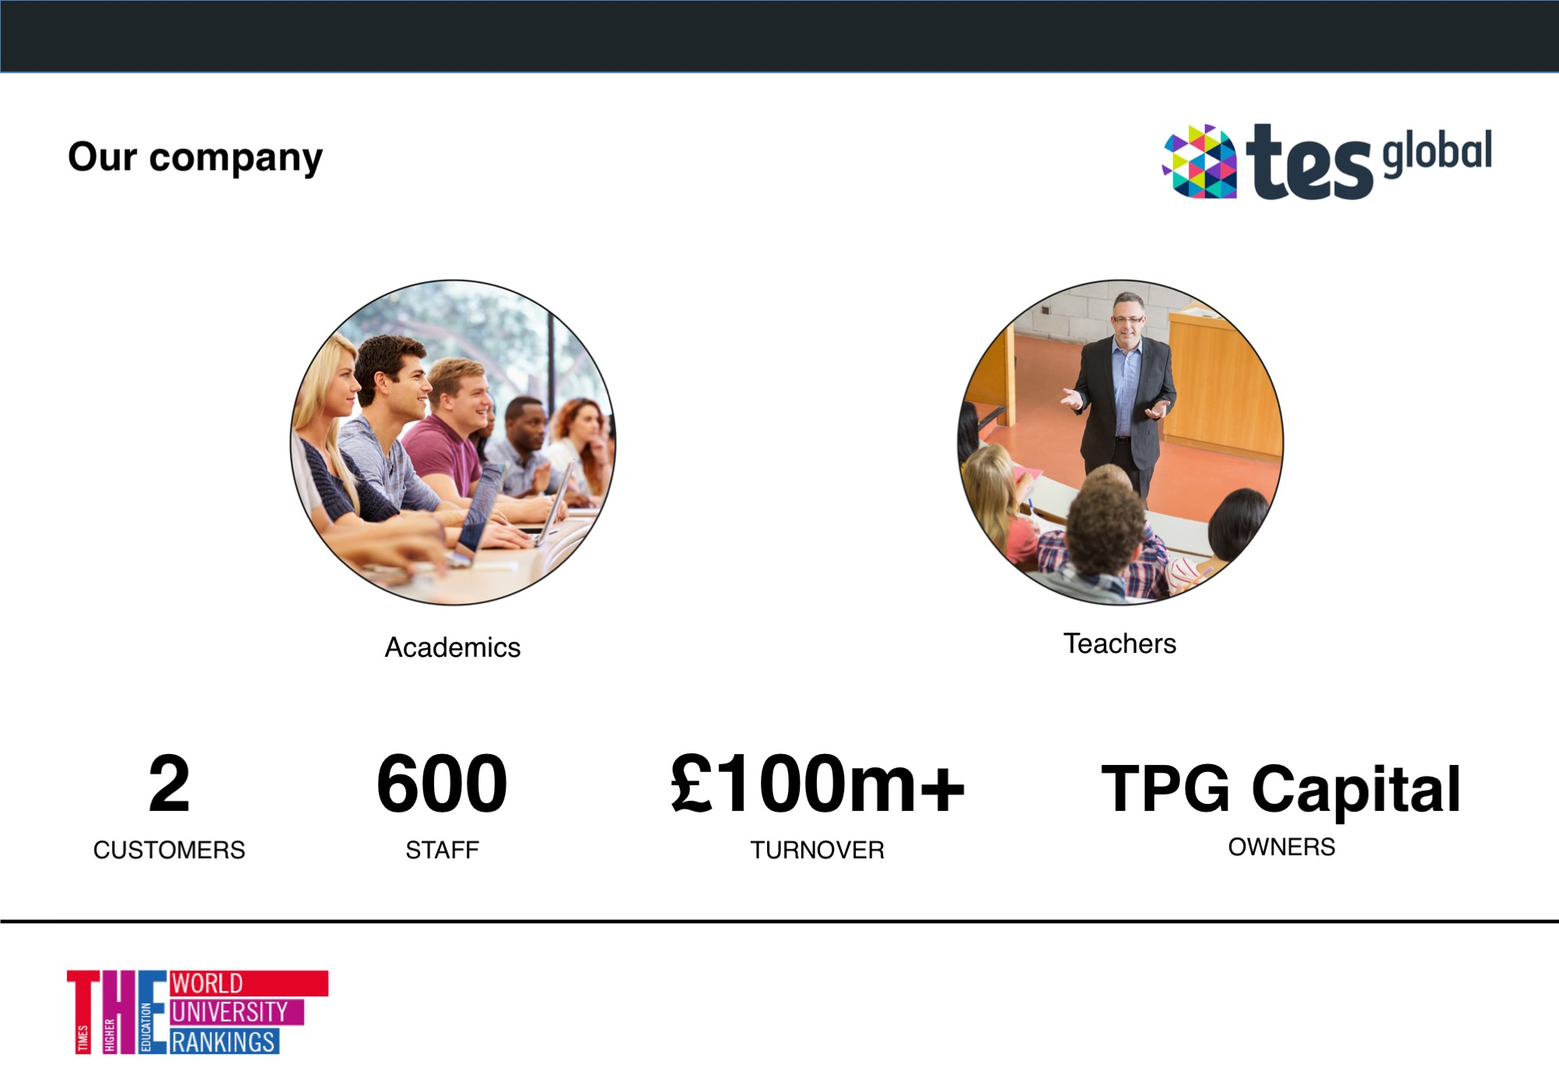

Slide 3
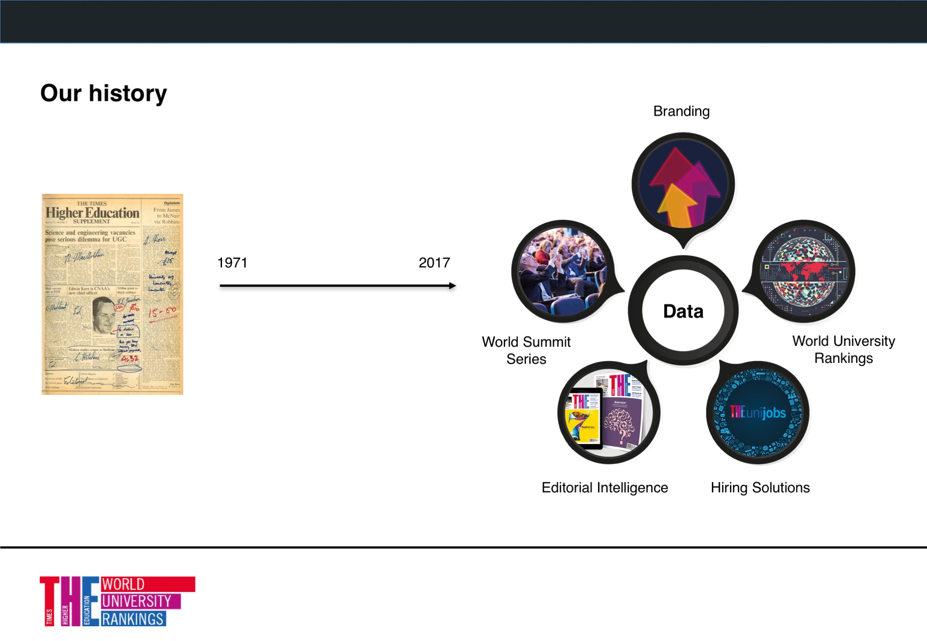

Slide 4
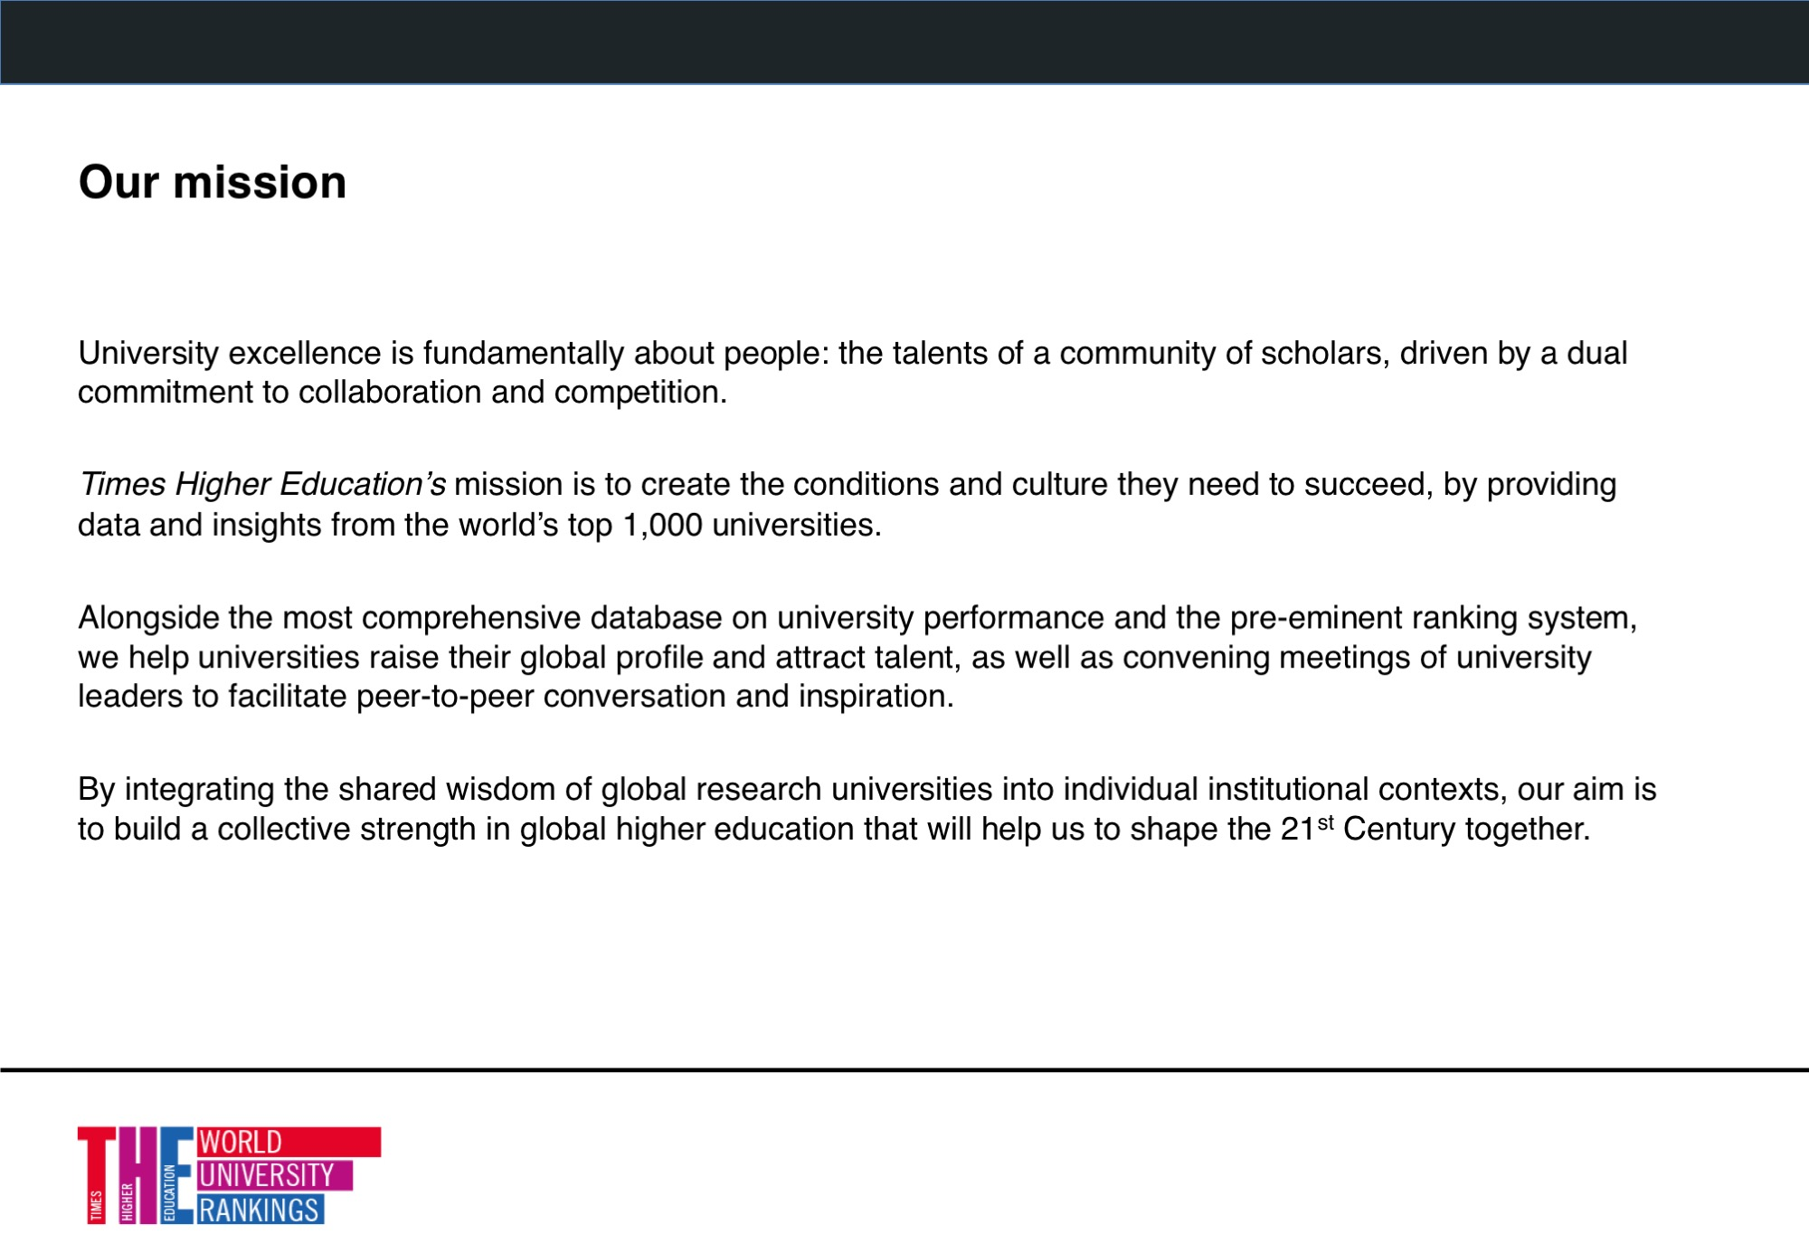

Slide 5
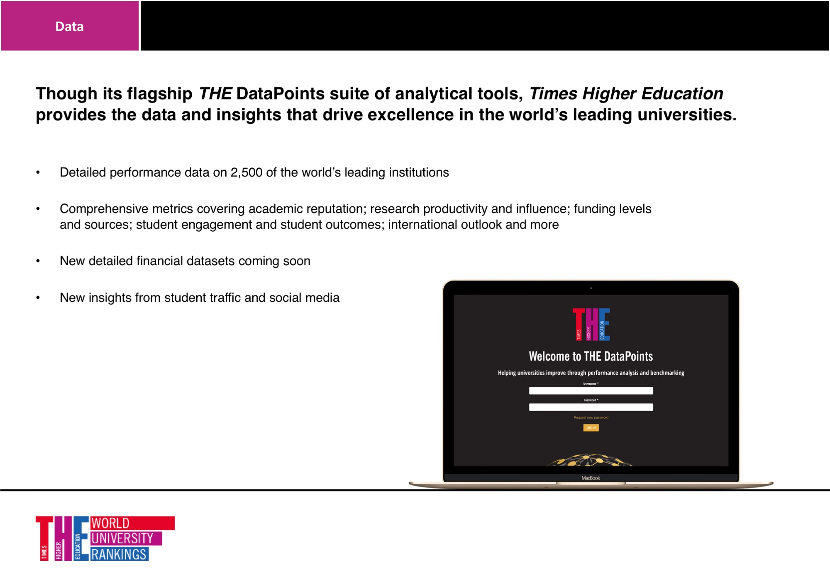

Slide 6
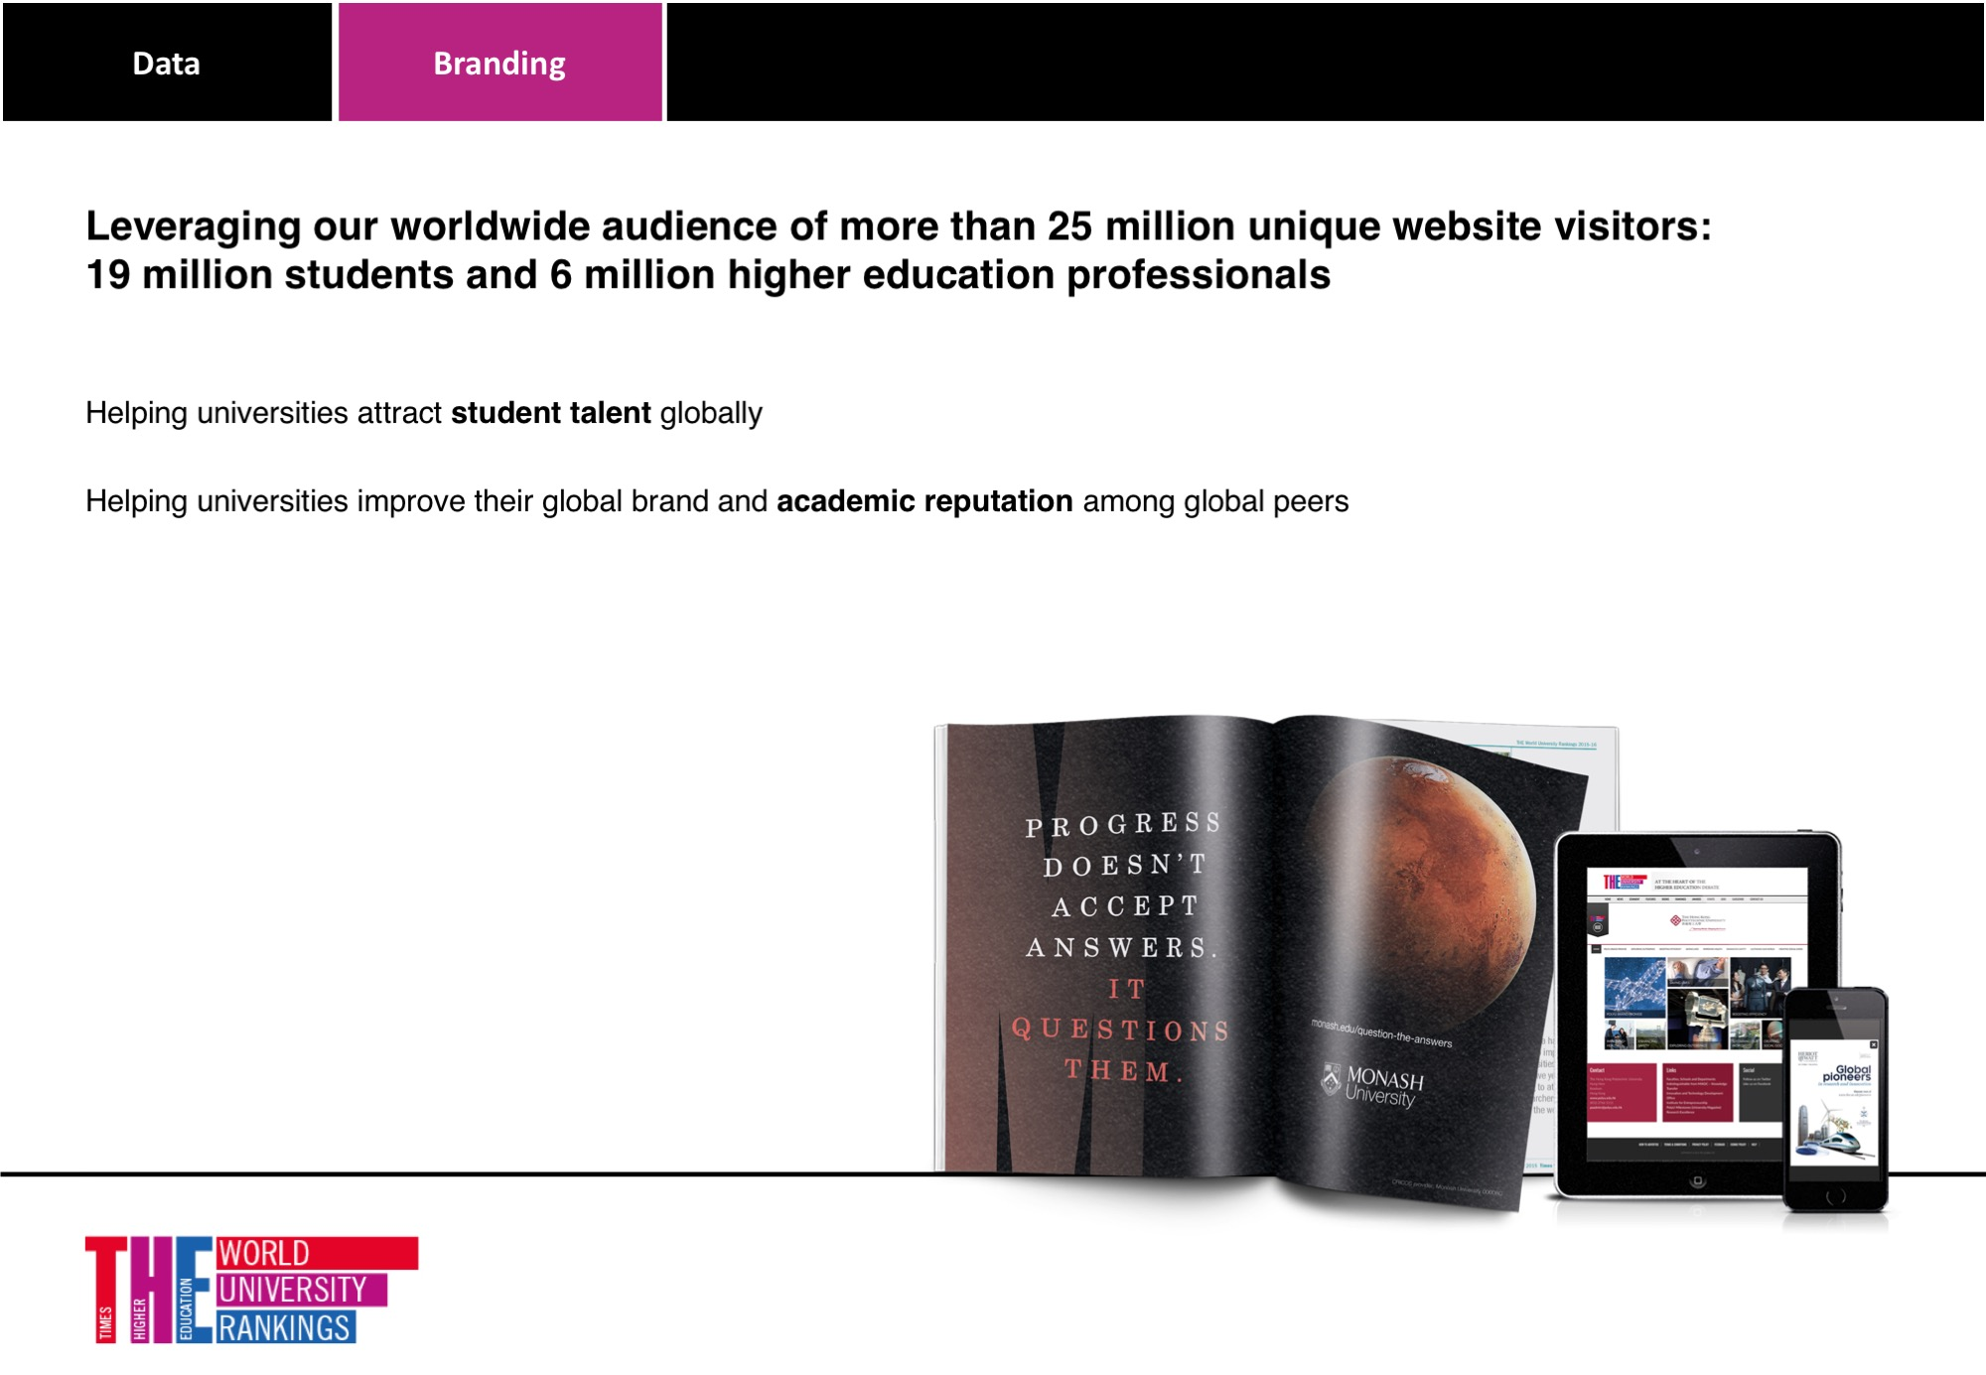

Slide 7
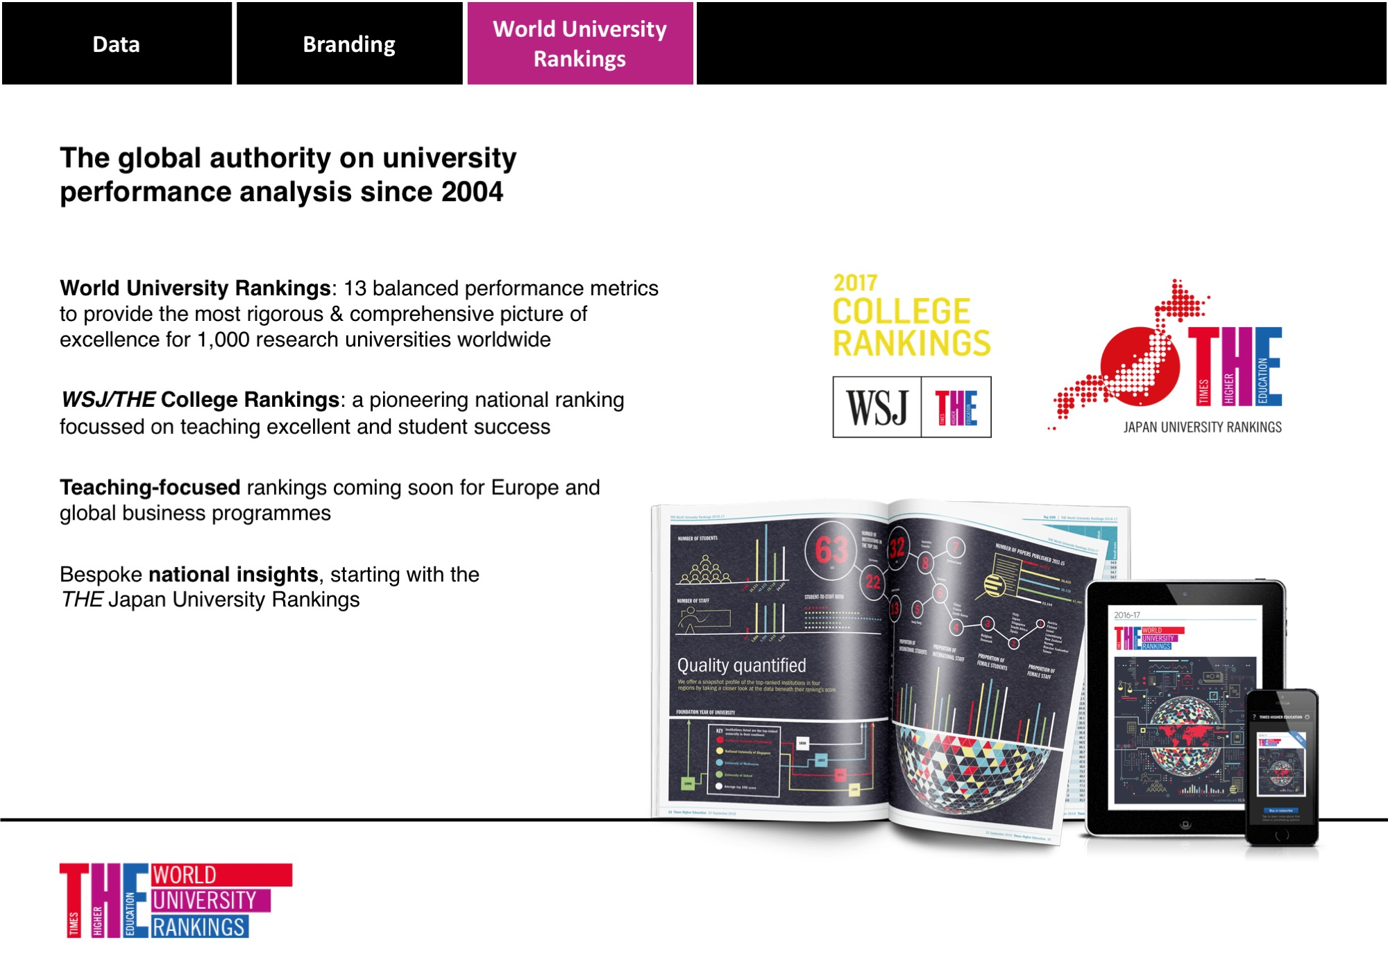

Slide 8


Slide 9
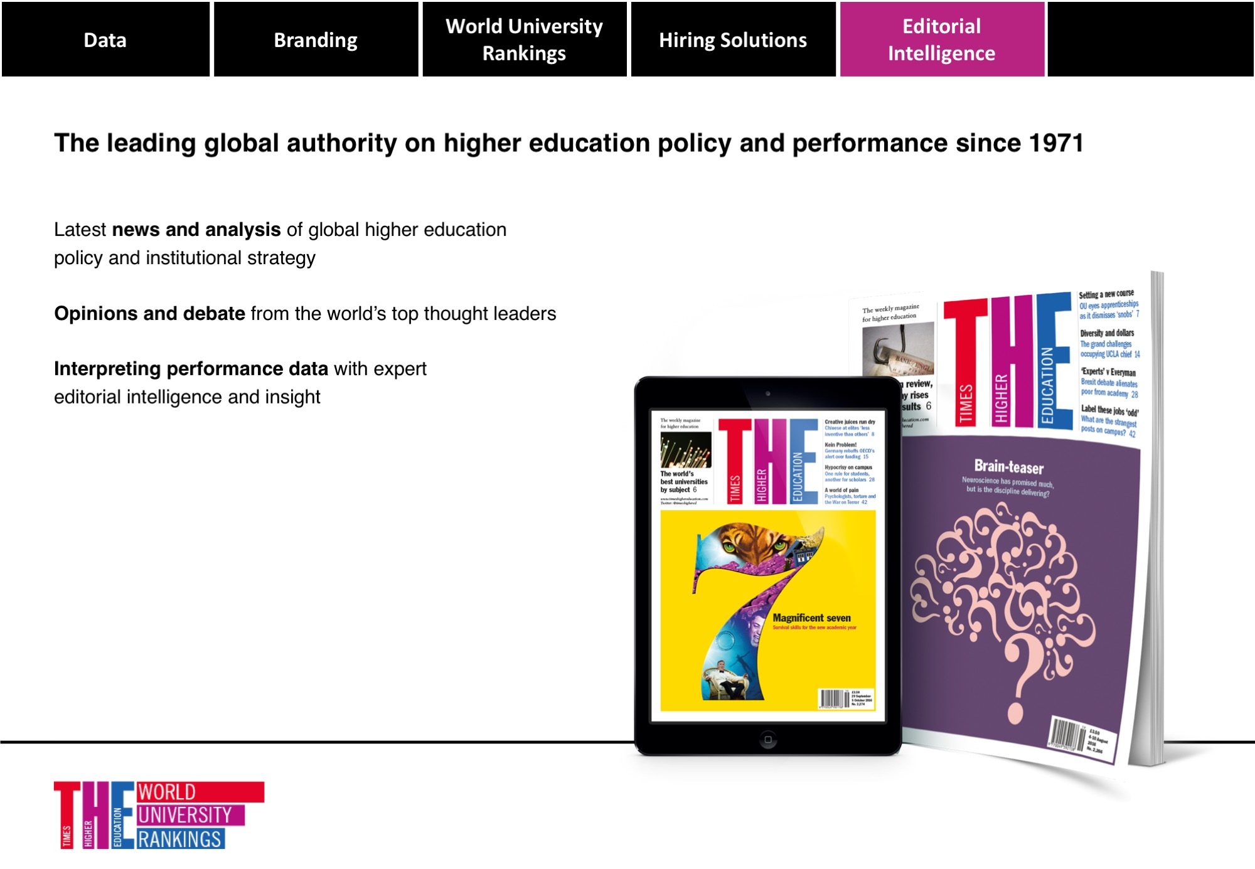

Slide 10
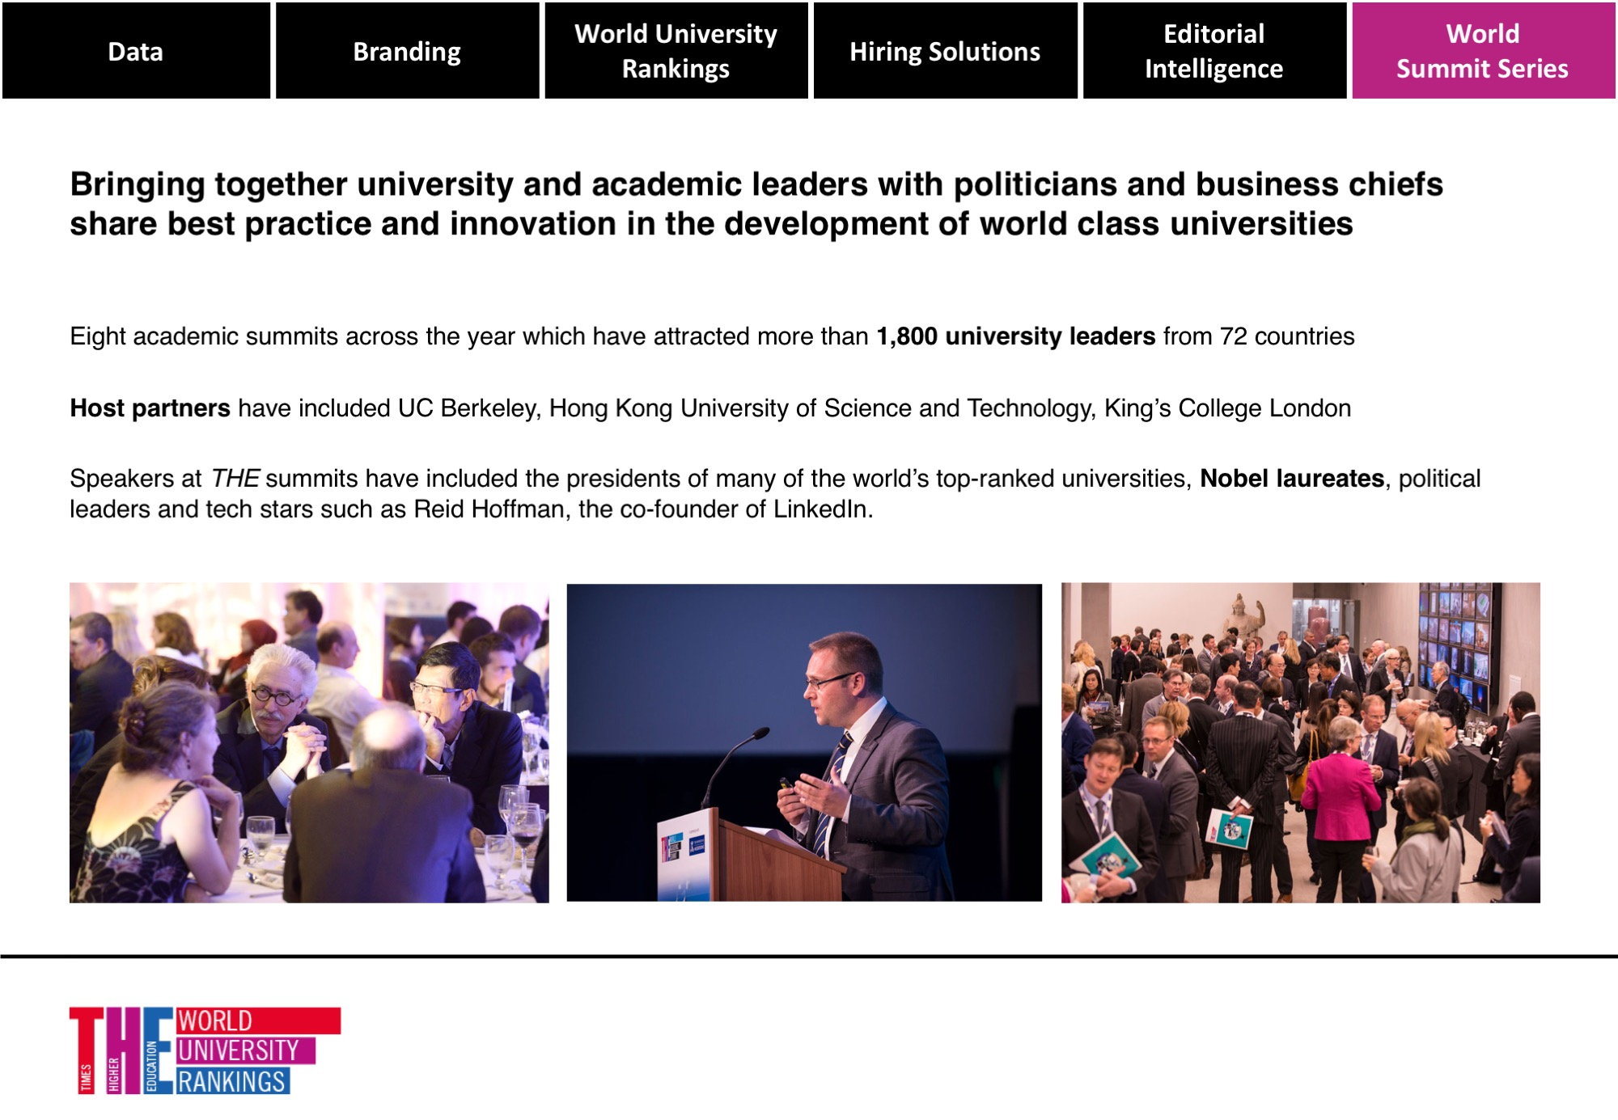

Slide 11
Data Masterclass:
A new analysis of European university performance
Phil Baty and Duncan Ross

Slide 12



Notes:
Times Higher Education has come a long way since it was first published five decades ago, and its biggest transformation has been driven by the World University Rankings.
When the World Rankings first came out, 12 years ago, in 2004, they were, we must admit, rather crude and simplistic. Today, they are a huge piece of research with a huge global inlfluence and reach.
Some numbers…

Slide 13







Entry Criteria
Notes:
We require activity in more than one of the subject areas
Evidence of significant number of undergraduate students

Slide 14
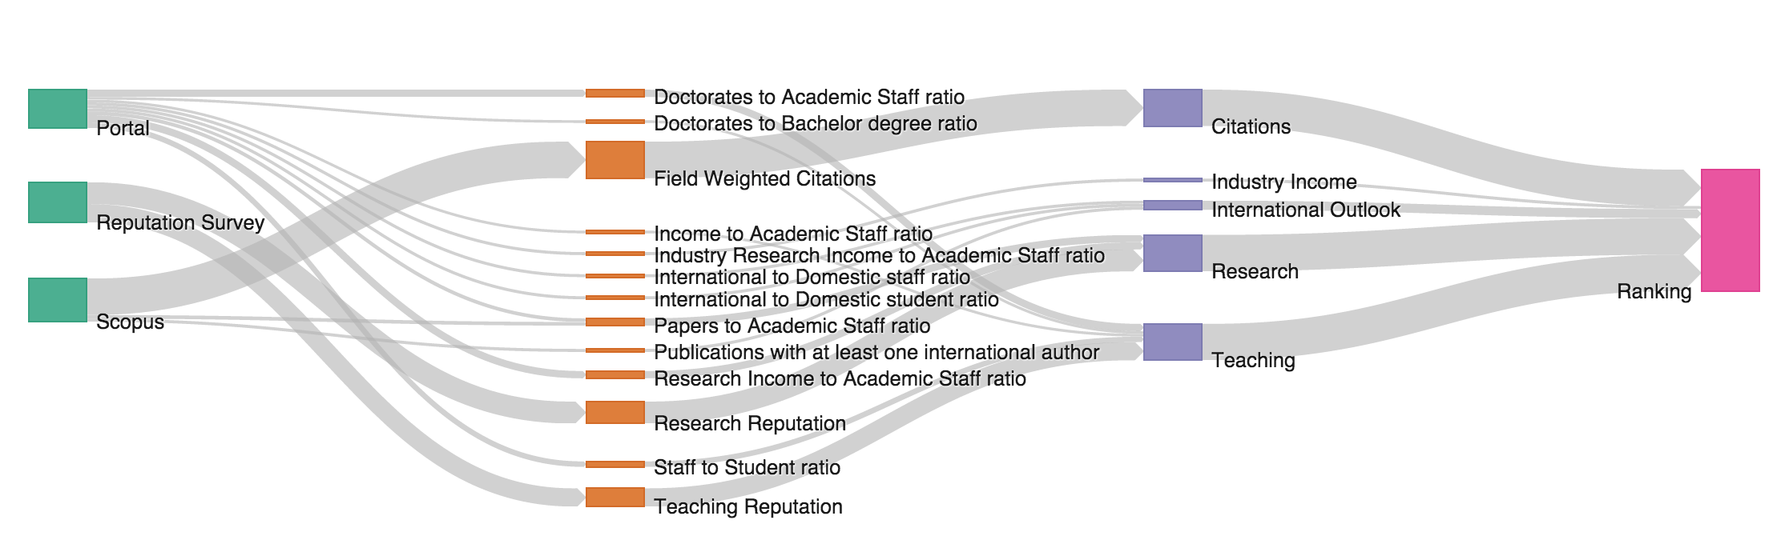
From foundations to methodology
Notes:
And all of this combines into the world’s most sophisticated, balanced and comprehensive rankings methodology.
Three data sources. Go into 13 separate performance indicators. Grouped into five pillars, which cover all core missions of the modern, research-led university.
13 indicators, across the all core aspects: teaching, research, knowledge transfer, international outlook.

Slide 15
Teaching
Teaching reputation
Teaching
Portal
Staff to student ratio
Doctorates to Bachelor awarded ratio
Doctorates awarded to academic staff ratio
World University Ranking
Institution income to academic staff
Research
Research reputation
Reputation survey
Research income to academic staff ratio
Paper to academic staff ratio
Citations
Citation impact
Scopus
Industry research income to academic staff
Industry income
International student percentage
International outlook
International staff percentage
International co-authorship

Slide 16
Research
Teaching reputation
Teaching
Portal
Staff to student ratio
Doctorates to Bachelor awarded ratio
Doctorates awarded to academic staff ratio
World University Ranking
Institution income to academic staff
Research
Research reputation
Reputation survey
Research income to academic staff ratio
Paper to academic staff ratio
Citations
Citation impact
Scopus
Industry research income to academic staff
Industry income
International student percentage
International outlook
International staff percentage
International co-authorship

Slide 17
Citations
Teaching reputation
Teaching
Portal
Staff to student ratio
Doctorates to Bachelor awarded ratio
Doctorates awarded to academic staff ratio
World University Ranking
Institution income to academic staff
Research
Research reputation
Reputation survey
Research income to academic staff ratio
Paper to academic staff ratio
Citations
Citation impact
Scopus
Industry research income to academic staff
Industry income
International student percentage
International outlook
International staff percentage
International co-authorship

Slide 18
Industry Income
Teaching reputation
Teaching
Portal
Staff to student ratio
Doctorates to Bachelor awarded ratio
Doctorates awarded to academic staff ratio
World University Ranking
Institution income to academic staff
Research
Research reputation
Reputation survey
Research income to academic staff ratio
Paper to academic staff ratio
Citations
Citation impact
Scopus
Industry research income to academic staff
Industry income
International student percentage
International outlook
International staff percentage
International co-authorship

Slide 19
International Outlook
Teaching reputation
Teaching
Portal
Staff to student ratio
Doctorates to Bachelor awarded ratio
Doctorates awarded to academic staff ratio
World University Ranking
Institution income to academic staff
Research
Research reputation
Reputation survey
Research income to academic staff ratio
Paper to academic staff ratio
Citations
Citation impact
Scopus
Industry research income to academic staff
Industry income
International student percentage
International outlook
International staff percentage
International co-authorship

Slide 20
Thirteen metrics
 | Doctorates to academic staff | Doctorates to bachelor’s degrees awarded | Teaching reputation | Income to academic staff | Staff to student ratio | Papers to academic staff | Research income to academic staff | Research reputation | Field Weighted Citations | Industry research income to academic staff | International to domestic staff | International to domestic student | Publications with international author
% | 6 | 2.25 | 15 | 2.25 | 4.5 | 6 | 6 | 18 | 30 | 2.5 | 2.5 | 2.5 | 2.5
Relative | Staff | Student body |  | Staff | Staff | Staff | Staff |  | Papers | Staff | Staff | Student body
Norm | Z | Z | Exp | Z | Z | Z | Z | Exp | Z | Z | Z | Z | Z
Subject weight | Yes |  |  |  |  | Yes | Yes |  | Yes* |  |  |  | Yes
PPP |  |  |  | Yes |  |  | Yes |  |  | Yes

Slide 21
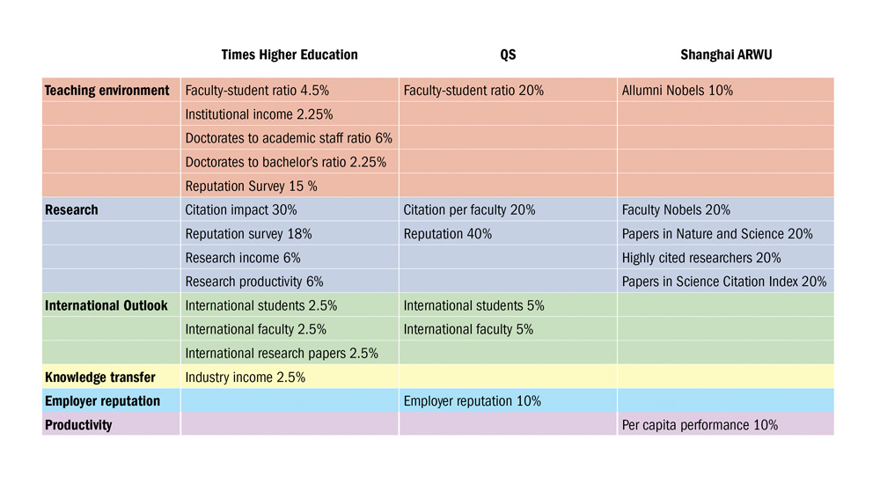
Other options are available
Notes:
I talked about why we rejected the QS system as being too simple. But here you can see that the system that THE rejected in 2009 is still used by QS today.
THE has five indicators of the teaching environment, compared to just one from QS, and one arguably very tenuous teaching indicator from Shanghai’s ARWU. The Shanghai ranking is extremely narrow – almost entirely about research, but the one basic nod to teaching is looking at where the Nobel prize winners did their undergraduate degrees. Very dubious as to how much an undergraduate degree contributes to someone’s ultimate success at the highest level of research, many decades later.
THE also has three indicators of international outlook, compared to QS’s two.
No other ranking has an indicator of knowledge transfer.
You can see: QS 50 per cent reputation, based on dubious surveys.

Slide 22
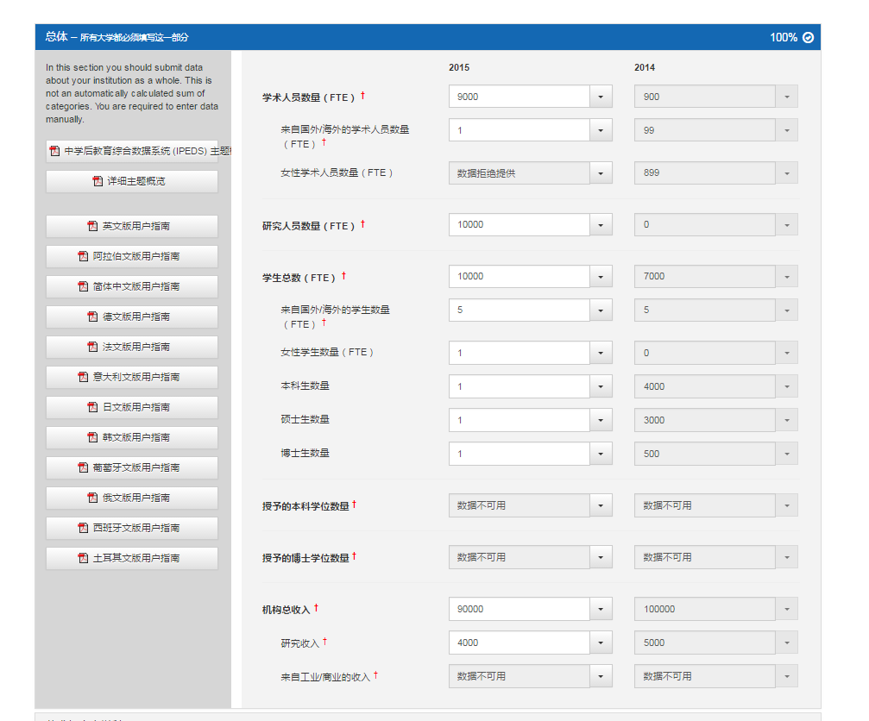
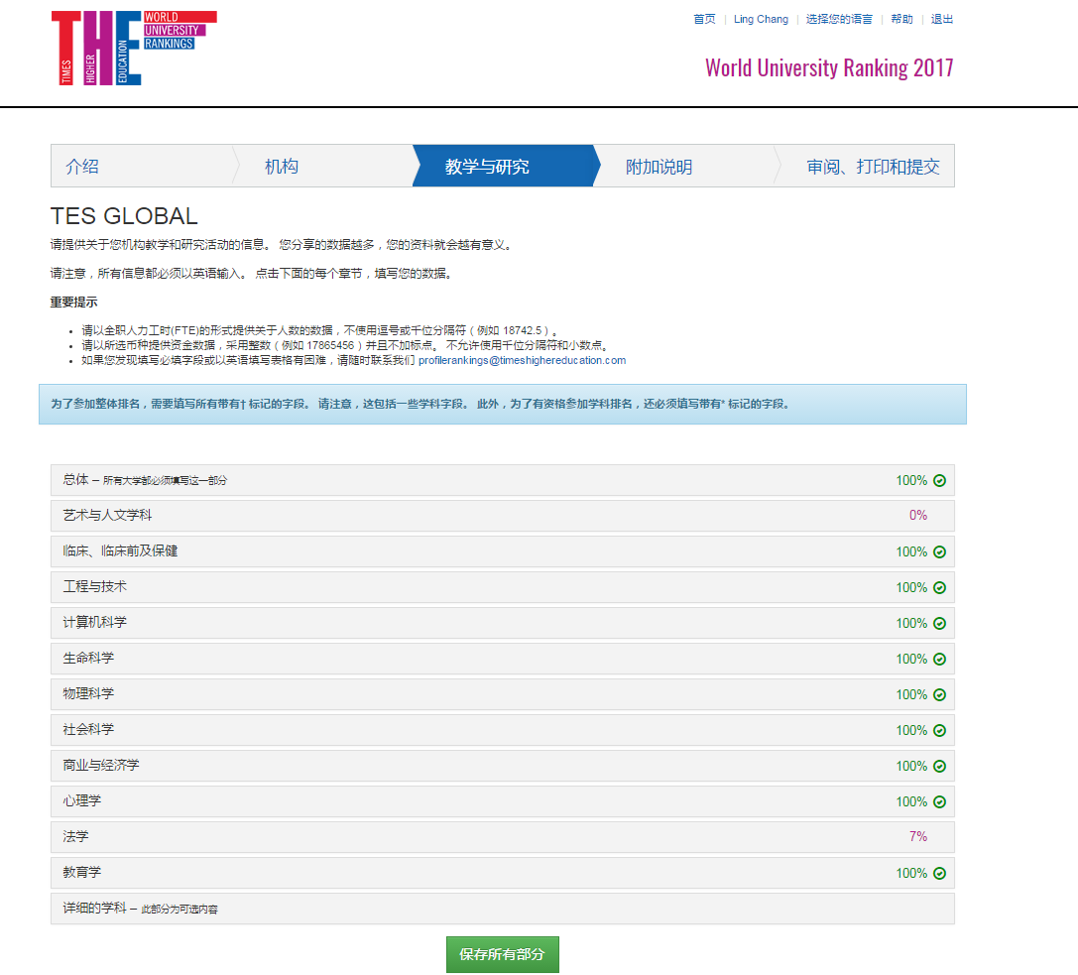
Data Source: Data Collection Portal
Notes:
For WUR2017 over 1300 participated

Slide 23
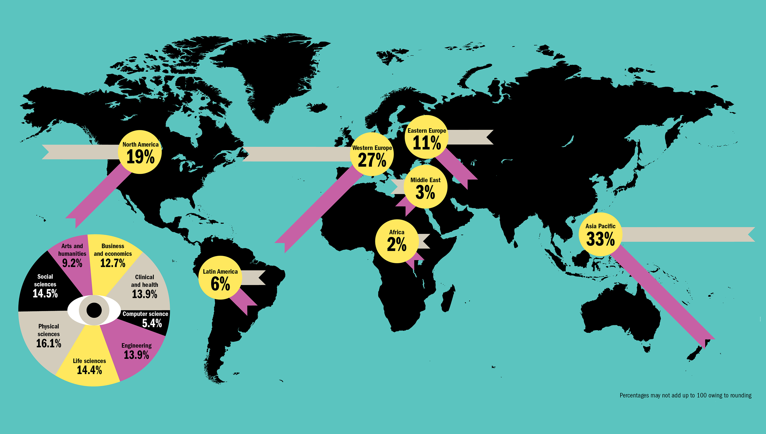
Data Source: Academic Survey
China
7%
Japan
9%

Slide 24
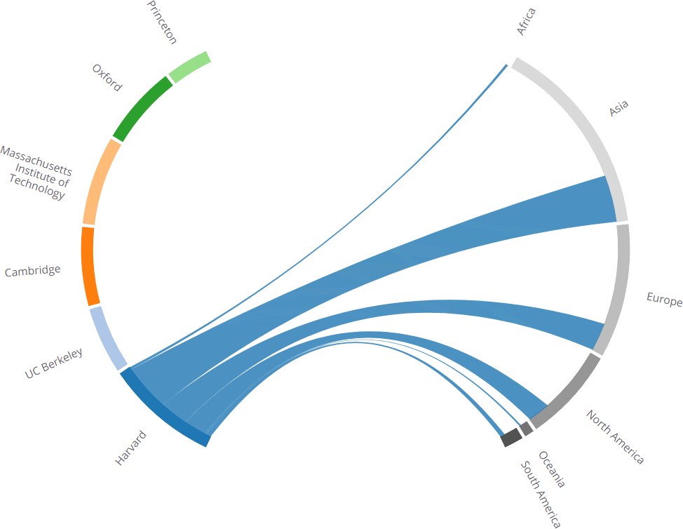
Superbrand Universities are Global

Slide 25
Perception by subject - MIT
Notes:
MIT

Slide 26
Perception by subject - Stanford
Notes:
Stanford

Slide 27
Perception by subject - Princeton
Notes:
Princeton

Slide 28
Perception by subject - Berkeley
Notes:
Berkeley

Slide 29
Perception by subject - Oxford
Notes:
Oxford

Slide 30
Perception by subject - Cambridge
Notes:
Cambridge

Slide 31
Perception by subject - Harvard
Notes:
Harvard

Slide 32
Data Source: Bibliometrics
Engineering & Technology
3.5M
Clinical, Pre-clinical & Health
3.8M
DOCUMENT TYPES
Article
8.61M
Article Review
685K
Conference Proceeding
2.06M
Books (series)
69K
Book chapters
451K
PERIOD
2011-2015
Physical Sciences
3.5M
Social Sciences
1.2M
Arts & Humanities
579K
Life Sciences
2.4M
Computer Science
1.5M
Business and Economics
400K

Slide 33
Methodology changes 2014-15
Change of Bibliometric supplier
Expansion of reach from 400 to 800 universities

Slide 34
Methodology changes 2016-17
Expanded reach from 800 to 980 Universities
Expanded from 6 to 8 subjects
  Business and Economics is separated from Social Sciences
  Computer Science is separated from Engineering and Technology
Reputation
  Country weighted based on response rates
  Average over two years

Slide 35

Independently audited by PwC
The calculation of our THE World University, and USA Ranking has been independently audited by professional services firm PricewaterhouseCoopers (PwC).
This audit is independent of any PwC consultancy on rankings and does not share information with other parts of PwC.

Slide 36
Planned methodology changes 2017-18
Expand range from 980 to 1000 Universities
Expand subjects from 8 to 11
Paper to subject ratio calculation improvement

Slide 37








Subject groupings
ARTS AND HUMANITIES Art, Performing Arts & Design (inc. Creative Arts) Languages, Literature & Linguistics History, Philosophy & Theology (inc. Classics) Architecture Archaeology | SOCIAL SCIENCES Communication & Media Studies Education Law Politics & International Studies (inc. Development Studies) Sociology (inc. cultural studies, population & anthropology) Psychology Geography | BUSINESS AND ECONOMICS Business & Management Accounting & Finance Economics & Econometrics | CLINICAL, PRE-CLINICAL AND HEALTH Medicine & Dentistry Other Health (inc. Nursing & Healthcare Services)
LIFE SCIENCES Agriculture & Forestry (inc. food) Biological Sciences (inc. biochemistry) Veterinary Science (inc zoology) Sports Science | PHYSICAL SCIENCES Mathematics & Statistics Physics & Astronomy Chemistry Geology, Environmental, Earth & Marine Sciences | ENGINEERING AND TECHNOLOGY General Engineering Electrical and Electronic Engineering Mechanical and Aerospace Engineering Civil Engineering (inc. Construction & Materials Science) Chemical Engineering | COMPUTER SCIENCE Computer Science

Slide 38


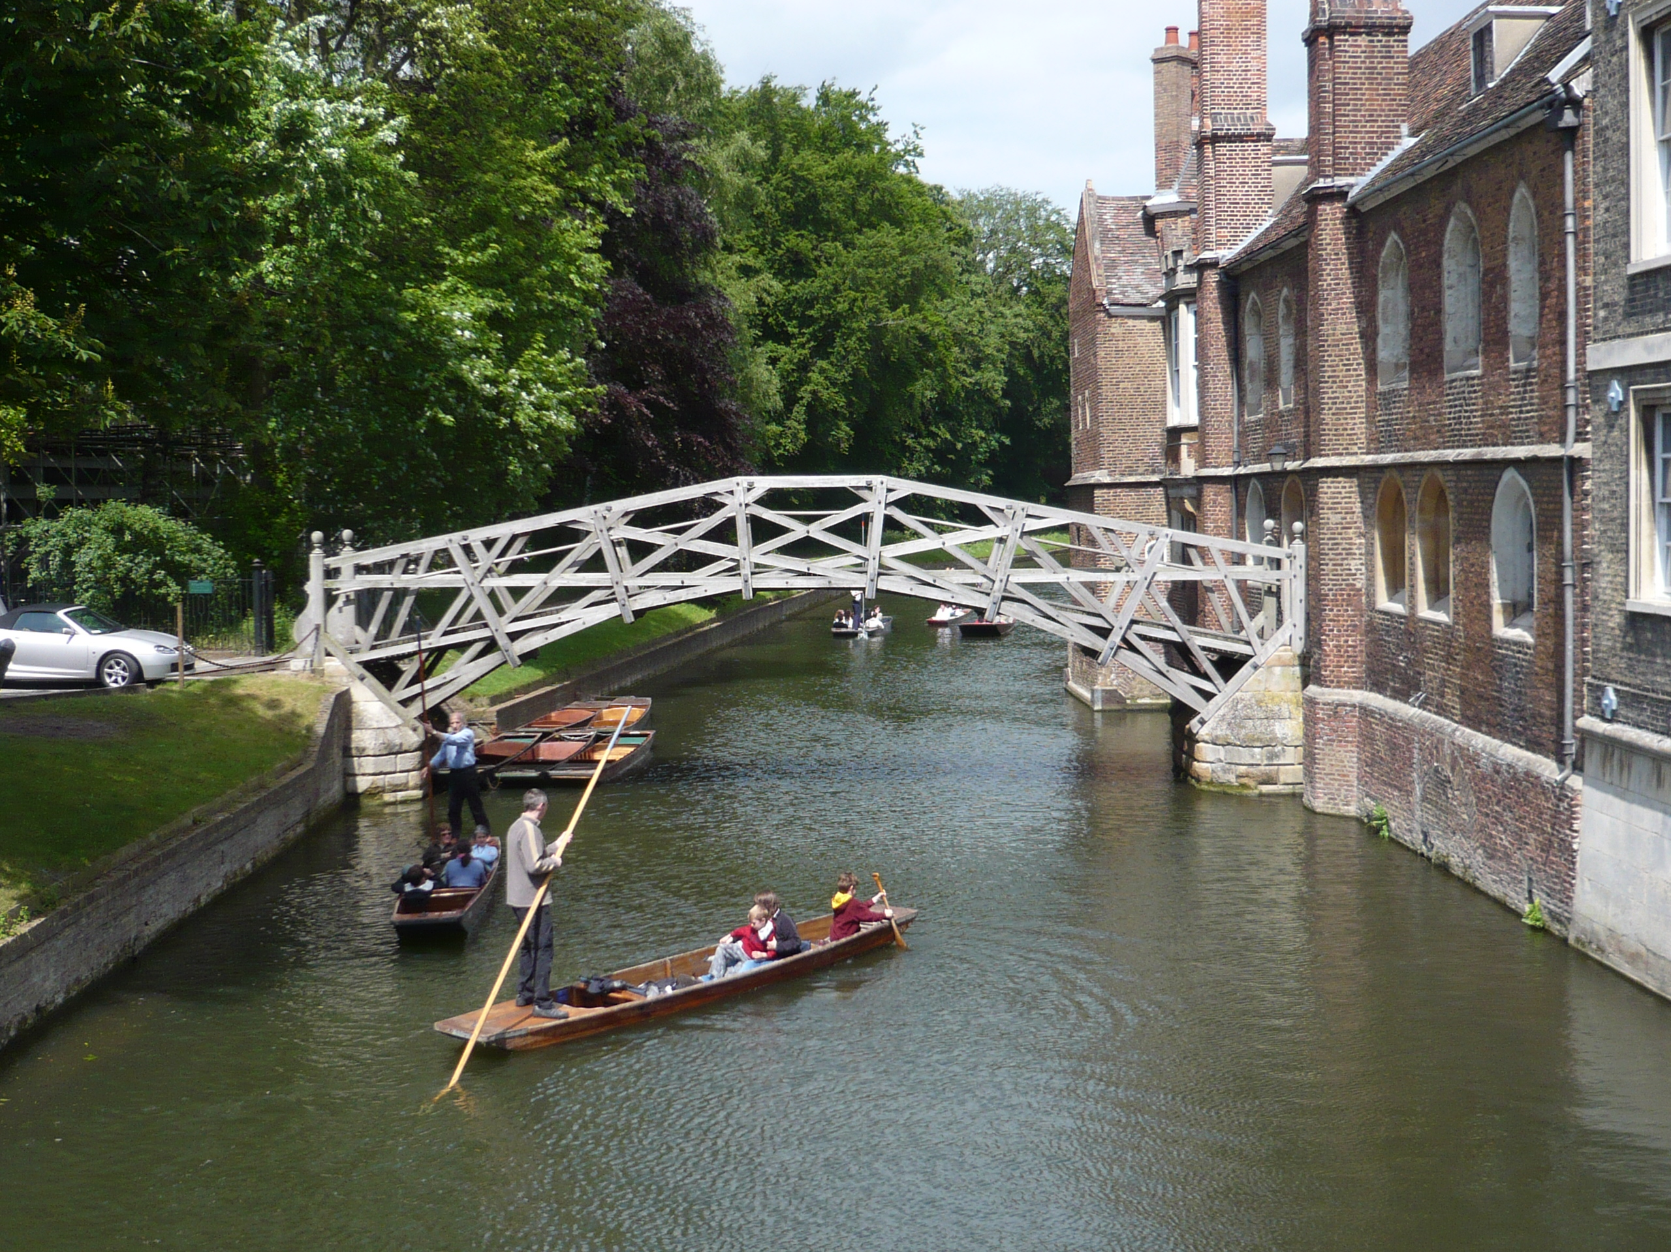
Subject groupings: changes 2017-18
Calculation changes
We will include Business Schools in the Business and Economics Ranking
We will extend coverage beyond the top 100
Thresholds are under review
SOCIAL SCIENCES Communication & Media Studies Politics & International Studies (inc. Development Studies) Sociology (inc. cultural studies, population & anthropology) Geography | LAW Law | EDUCATION Education | PSYCHOLOGY Psychology

Slide 39
Ranking cycles
World University Ranking methodologies
Teaching methodologies
Name | Date | Data collection cycle
Reputation | 15/06/17 | 2017
Europe | 22/06/17 | 2016
SE Asia | 05/07/17 | 2016
Latam | 20/07/17 | 2017
World (15th Edition) | 05/09/17 | 2017
Subjects | Sep-17 | 2017
BRICS | Dec-18 | 2017
Asia | Feb-18 | 2017
Young | Spring 2018 | 2017
Name | Date | Data collection cycle
US College (2nd Edition) | 28/09/17 | 2017
MBA | Early Spring 2018 | 2017
Japan University (2nd Edition) | Spring 2018 | 2017
Europe | Summer 2018 | 2017

Slide 40
Insights: Europe

Slide 41
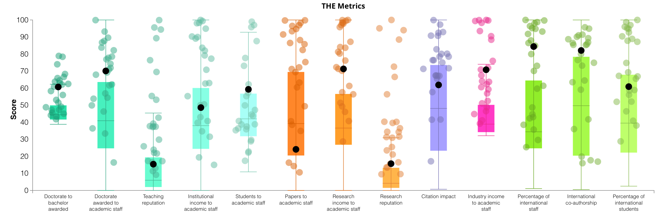
World
How do all World Universities perform?
How does Europe compare?

Slide 42
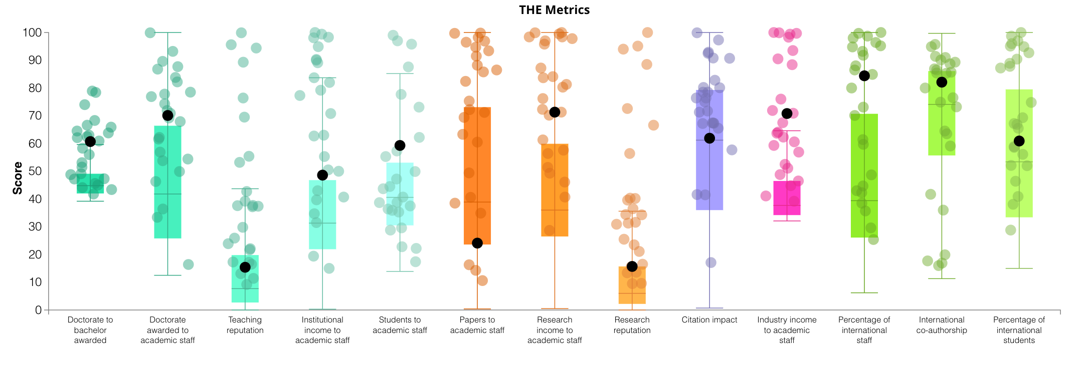
Europe
Stronger in citations
Stronger in International Outlook
Weaker in Industry Income
Weaker in Institutional Income

Slide 43
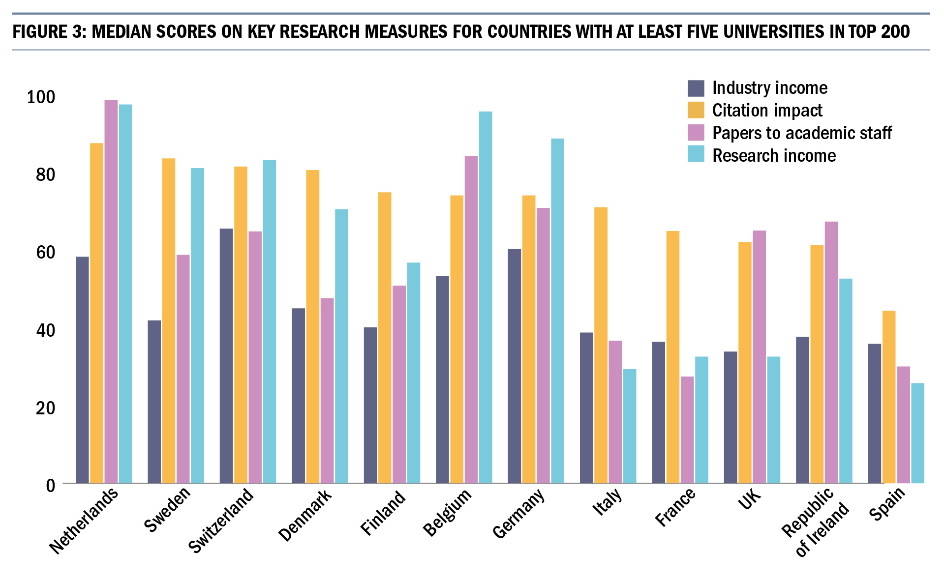
Europe shows wide variation

Slide 44
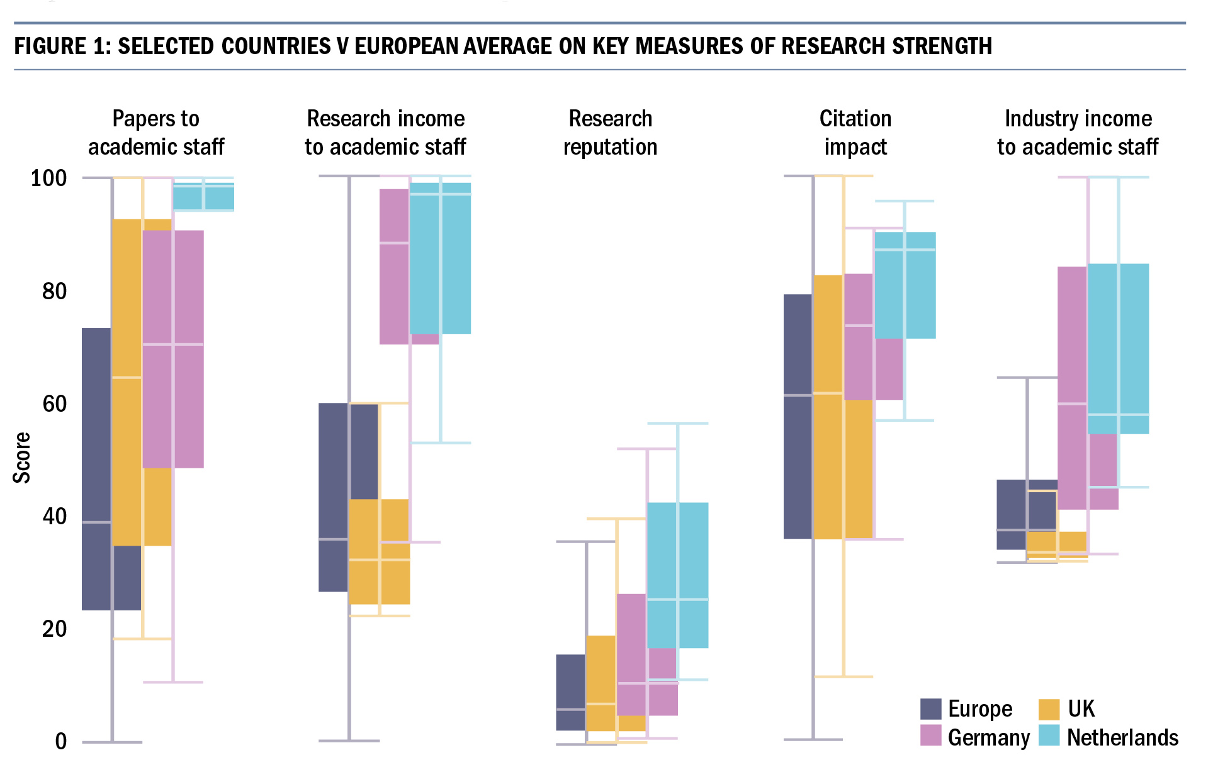
Research

Slide 45
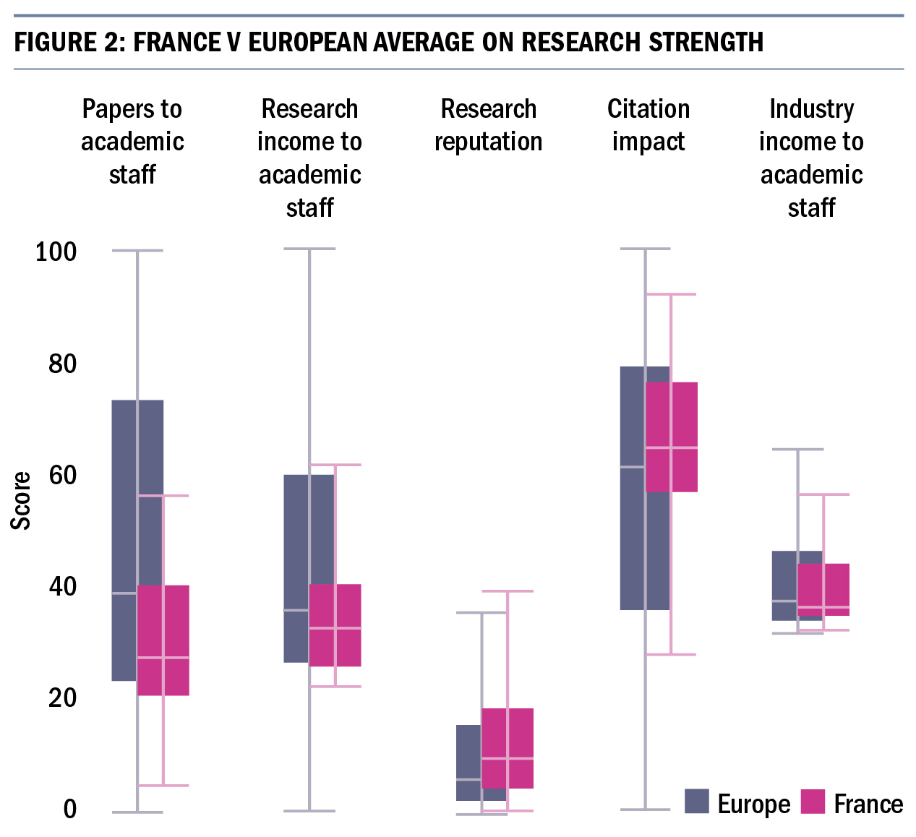
Research

Slide 46
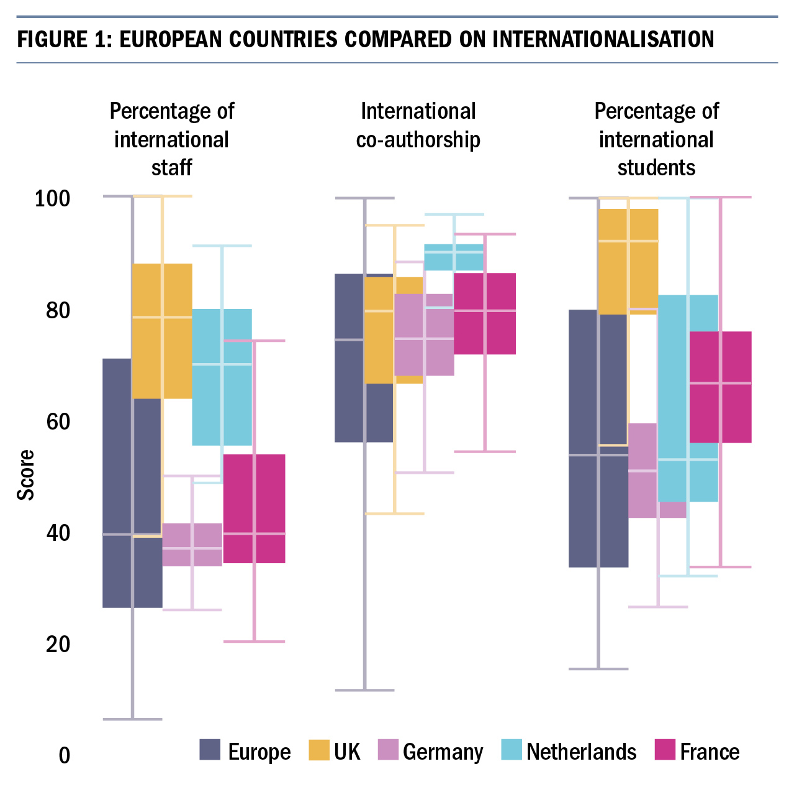
International outlook

Slide 47

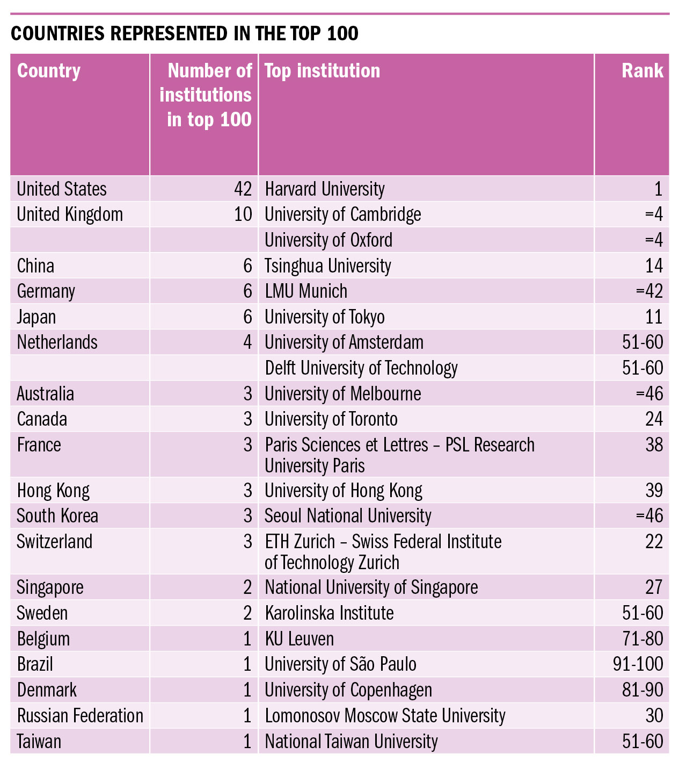
Notes:
Look at the full top 100 list.
US 42 – down one from 43 last year. First major survey of academic opinion since Trump’s inauguration shows a bit of a hit to US reputation: Fewer top 100 brands, and bit names like Colombia down, Michigan down, Penn, down, Cornell down, Northwestern down, Uni of Washington down, Illioni Urbana Champaign down, Carneigie Mellon down. Dare I speak of a Tump effect here? Survey was Jan to end of March 2017
UK next with 10 – same as last year but down from 12 in 2015.
Canada 3, UofT in 24th, Tokyo is Asia’s most prestigious institution in 11th. France has a major new entry – PSL new at 38th – considered as a single entity for the fist time.
Brazil’s USP number one in Lat Am – 91-100 group. Russia does eye-catchingly well with Moscow State in 30th place – same as last year.
But the big news, for me, is that China has made dramatic gains…

Slide 48
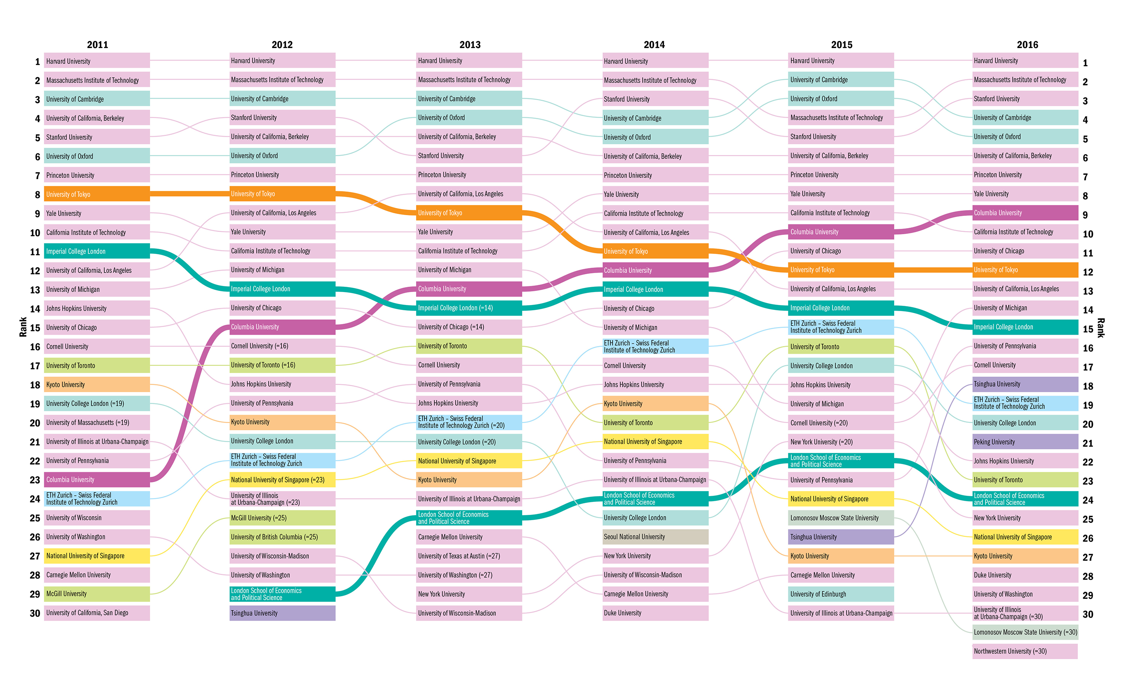
Reputation overview
Notes:
A look at the top.
Not expecting you to read. But colours show each country. Pink is US. 19 in 2011. 19 in 2016.
Six countries in top 30 in 2011. Eight countries in 2016 – No China in 2011. Two in top 30 in 2016. Also no Russia back then.

Slide 49
Harvard University
Reputation and Europe
Massachusetts Institute of Technology
Stanford University
University of Cambridge
University of Oxford
European institutions are still performing well
However, the rise of Asian giants is a noticeable change
The ranking is still dominated by US institutions
University of California, Berkeley
Princeton University
Yale University
University of Chicago
California Institute of Technology
University of Tokyo
Columbia University
University of California, Los Angeles
Tsinghua University
University of Michigan
University College London
Peking University
Imperial College London
University of Pennsylvania
London School of Economics
and Political Science
Johns Hopkins University
ETH Zurich
Cornell University
University of Toronto
Kyoto University
New York University
National University of Singapore
Duke University
University of California, San Diego
Lomonosov Moscow State University
Notes:
A look at the top.
Not expecting you to read. But colours show each country. Pink is US. 19 in 2011. 19 in 2016.
Six countries in top 30 in 2011. Eight countries in 2016 – No China in 2011. Two in top 30 in 2016. Also no Russia back then.

Slide 50
Eurovision

Slide 51
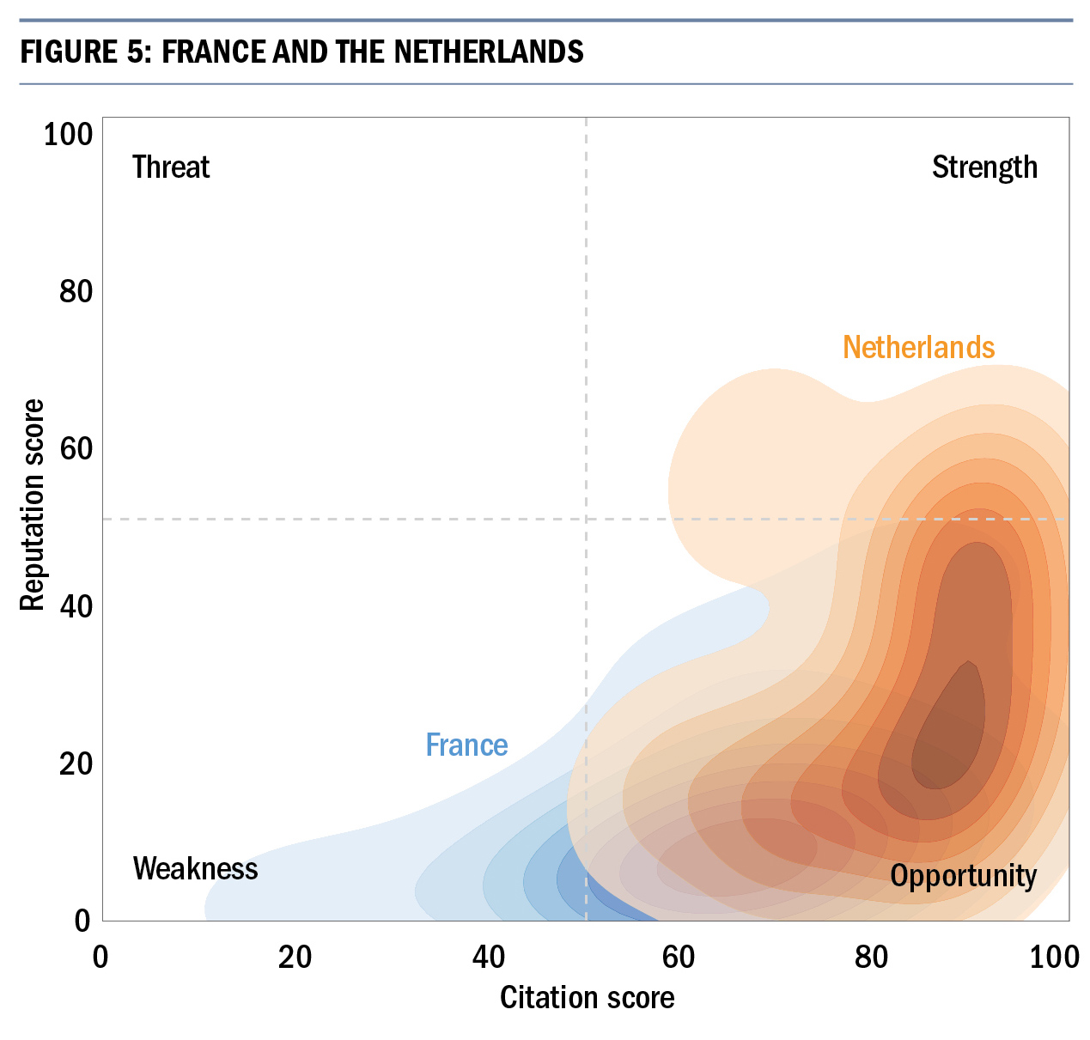
Objective and subjective measures

Slide 52
Understanding teaching

Slide 53
Today is TEF day in the UK…
NSS
Teaching on my course
Gold
Assessment and feedback
HESA
Academic support
ILR
Silver
Non-continuation
DLHE
Employment
Bronze
15 pages of explanation
High skilled employment

Slide 54
Exploring teaching
Presage
Process
Product
Student factors
Prior knowledge
Ability
Motivation
Learning focused activities
Learning outcomes
Skills
Facts
Involvement
Teaching Context
Objectives
Assessment
Climate/ethos
Teaching procedures

Slide 55
From theory to a teaching framework
Resources
Engagement
Outcomes
Environment
Teaching Context
Objectives
Assessment
Climate/ethos
Teaching procedures
Student factors
Prior knowledge
Ability
Motivation
Teaching Context
Objectives
Assessment
Climate/ethos
Teaching procedures
Presage
Learning focused activities
Process
Learning outcomes
Skills
Facts
Involvement
Product

Slide 56
TEF Methodology
NSS
Teaching on my course
Gold
Assessment and feedback
HESA
Academic support
ILR
Silver
Non-continuation
DLHE
Employment
Bronze
15 pages of explanation
High skilled employment

Slide 57
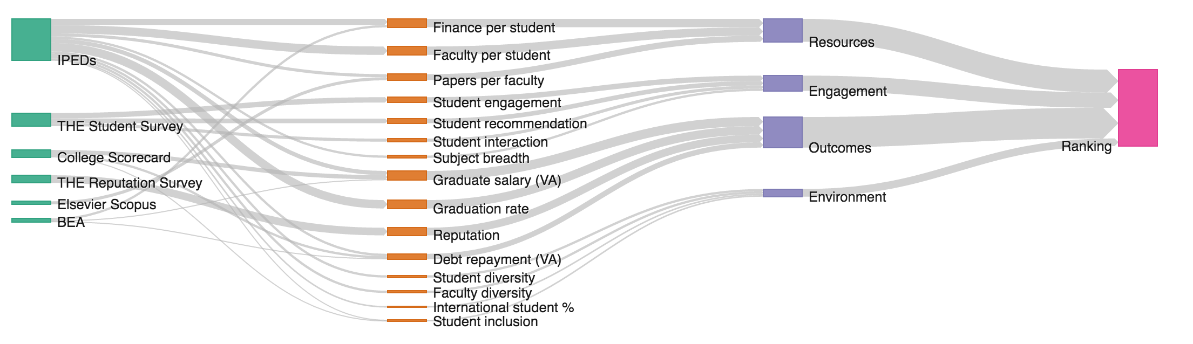
WSJ/THE College Rankings Methodology

Slide 58










Top 10 US Colleges
1 | Stanford University
2 | Harvard University
3 | MIT
4 | University of Pennsylvania
5 | Columbia University
6 | Yale University
7 | Duke University
8 | Cornell University
9 | Princeton University
10 | Northwestern University

Slide 59
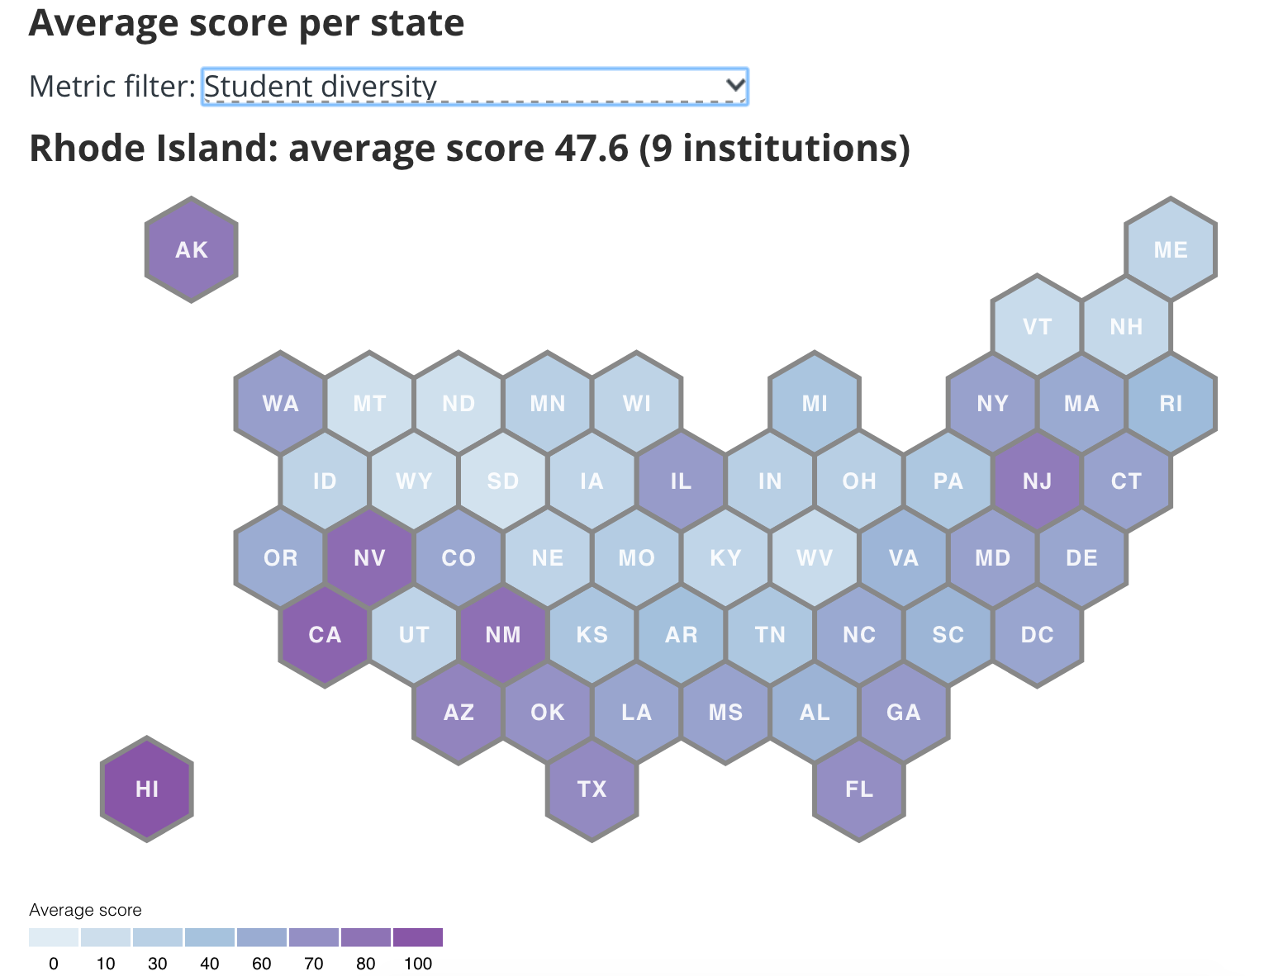
Exploring diversity across the USA

Slide 60
THE US Student Survey – the bigger picture
Motivation
Impact on career
Satisfaction and value
Engagement with learning

Slide 61


THE US Student Survey
Current students in taught courses
Around 1,300 colleges targeted
Focused samples
Engagement managed by established market research organizations
The result: 100,000 students in over 1,111 colleges

Slide 62
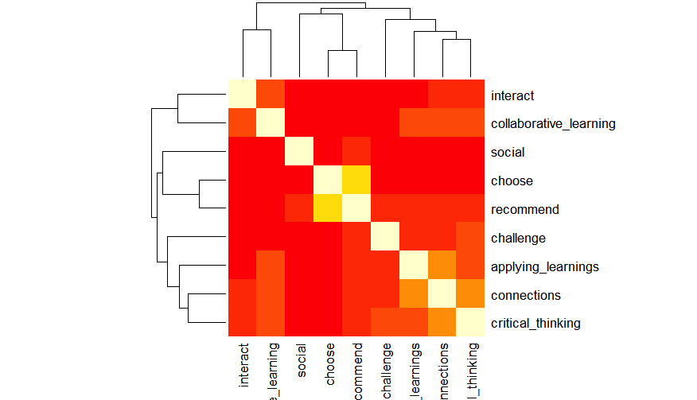
THE US Student Survey – creating indicators
Measures used in the ranking
  Faculty interaction
  Collaborative learning
  Recommendation
  Practical application
  Reflection / connection
  Critical thinking
  Challenging classes
Other measures
  Choice, career impact, value
  Social engagement

Slide 63
Teaching in Japan

Slide 64
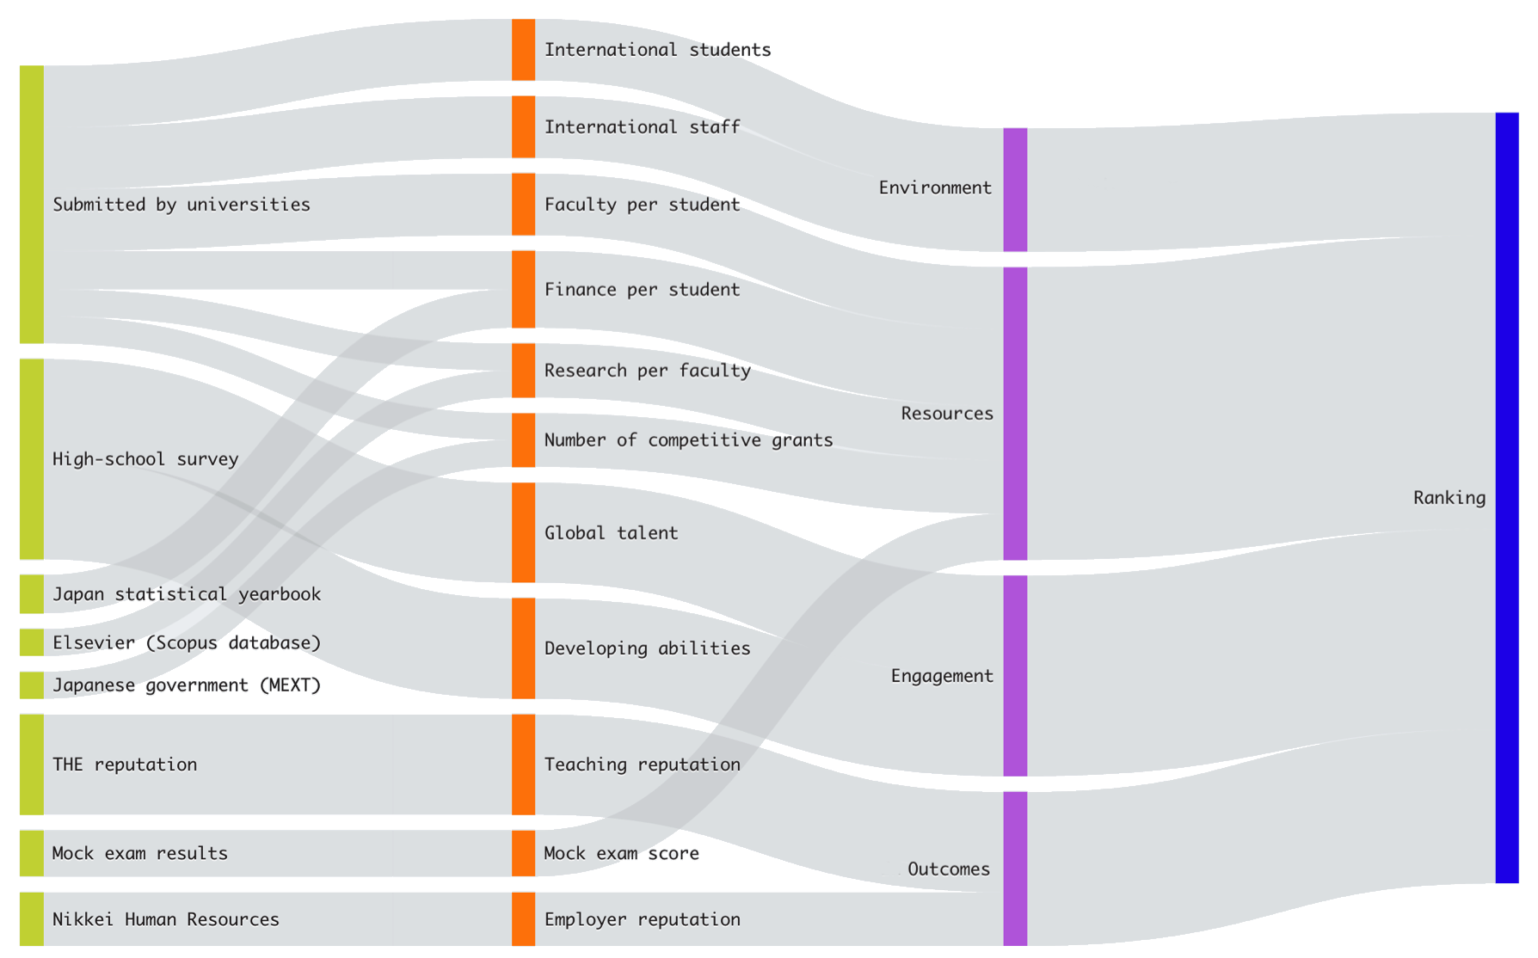
Methodology

Slide 65










Top 10 Japanese Universities Overall
1 | Tokyo University | 東京大学
2 | Tohoku University | 東北大学
3 | Kyoto University | 京都大学
=4 | Nagoya University | 名古屋大学
=4 | Tokyo Institute of Technology | 東京工業大学
6 | Osaka University | 大阪大学
7 | Kyushu University | 九州大学
8 | Hokkaido University | 北海道大学
9 | University of Tsukuba | 筑波大学
10 | Waseda University | 早稲田大学

Slide 66
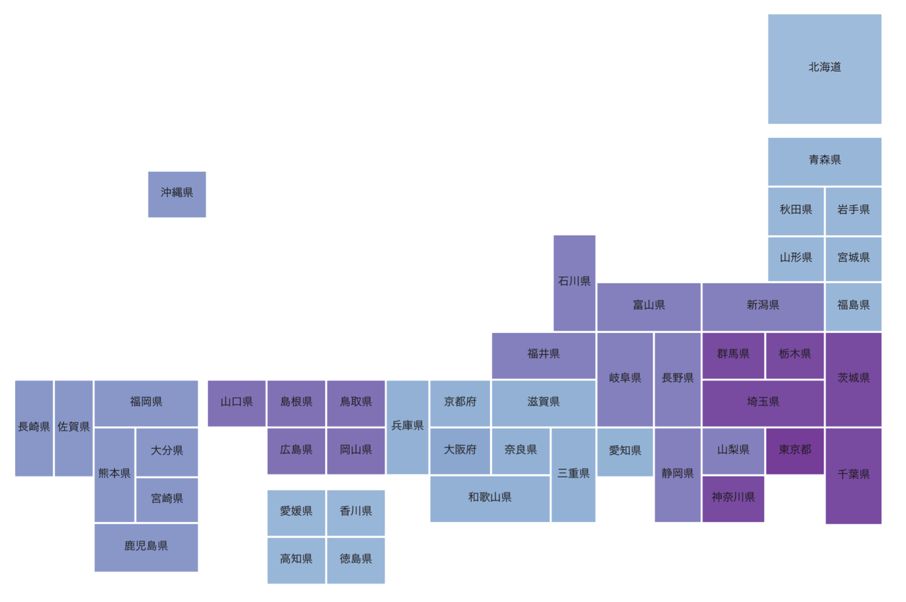



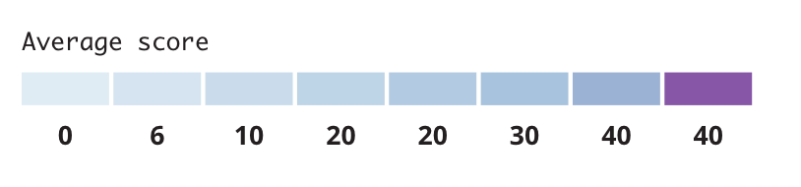
Exploring Environment
Notes:
Am dropping those above the visual noise – it takes too much space
Let me know if you want another metric to view instead.

Slide 67
Consultation: European Teaching

Slide 68
Where is Europe? Who should be included?
Full member of EHEA + classified as 'developed economy' based on UN country classification
OECD country
Student Survey feasibility / easiness to conduct survey
Geography + contiguity

Slide 69
THE coverage
Notes:
Total number of institutions in European Teaching Ranking 1176

Slide 70
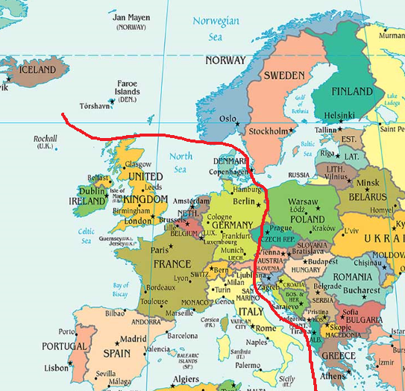
Probable coverage
Notes:
EHEA – European Higher Education Area
OECD - Organisation for Economic Co-operation and Development

Slide 71
Surveying European Universities
Notes:
Question was not mandatory. Blanks removed from analysis

Slide 72
Data availability

Slide 73
Methodology v.0.2
RESOURCES
ENGAGEMENT
OUTCOMES
ENVIRONMENT
Staff to student ratio
Papers to academic staff
Finance per student
Quality of services available to students
Student recommendation
Student engagement
Student career preparation
Interaction with teachers and students
Academic reputation
Bachelor student internships
Continuing study
Proportion of international students
Proportion of international academic staff
Proportion of senior female academic staff
Proportion of female students
Notes:
The indicators highlighted in red may need refinement: what I was thinking (as of 23 May 17) is the following:
Bachelor student internships - Linkages to labour market - Out of all the institution’s students who did an internship, the percentage of bachelor students who did an internship with a company or organization in the region or abroad. (Internships of students are a means to connect students to the labour market.
A relative large percentage of bachelor students reflects a strong interest to build co-operations and to prepare the student for real world experience.)
Continuous study - Alternative to student retention - Proportion of first degree students that continue with their studies beyond first year (Does my college succeed in getting people to the end of the course? How well supported are students throughout their course? A relatively high proportion here indicates a good personal connection that first year students have with the institution so that they want to stay on)
Proportion of senior female academic staff – current definition: Number of women who have achieved senior status in universities: (tenured) professorships, deanships, chancellorships (rector/president), vice-chancellor- and deputy vice-chancellorships

Slide 74
Potential indicators: Resources

Slide 75
Potential indicators: Resources - comments
Average of course hours taught by teachers
Accessibility of the institution and diversity of the student body is of growing importance. This includes students following different studypaths from the mainstream careers. With diminishing loan capacity and rising tuition fees, demand for life long learning and flexible (part time) learning grows. In research, quality (impact and grants awarded) is gaining weight against sheer volume.
Full time coverage: the proportion of courses which are primarily delivered by full-time tenured faculty Library expenditure IT expenditure
Quality of services available to students can not be measured in figures
Availability of resources: books, journals, electronic media, working space
Workplace experience through internships and placements. Final Year Project must demonstrate independent research. Programmes of study relevant to industry, business and other needs. Graduate employability.

Slide 76
Potential indicators: Engagement

Slide 77
Potential indicators: Engagement – comments
Blended forms of learning (through better use of IT opportunities) compromises the definition of these parameters. Also, joint degrees and the blending of subjects taught at different institutions into one degree, seem to counteract these parameters but should not appear to signal lesser quality of teaching.
This question is a qualitative one. We try our best to encourage student to have the feeling of "appartenance" (a feeling to entirely belonging to the university, affectionnately and professionally).
Cooperative education workplace placement for all students. Careers Support Office. Student Satisfaction Surveys. Learning Support Centres on campus.
Student retention rate - as a high withdrawal rate would indicate problems with the quality of student engagement.
Student participation through clubs and societies as a measure of social interaction

Slide 78
Potential indicators: Outcome

Slide 79
Data availability: student outcomes

Slide 80
Potential indicators: Outcomes - comments
Currently, the debate is about what constitutes 'quality': the absolute level reached by the graduates or the jump they made during the programme (value attained vs value added). Both aspects should be reflected in any ranking -- also to prevent a bias between institutions which do and do not have selection power over their enrolment.
Graduate satisfaction: graduate self-reported overall satisfaction 5-10 years after graduation
Since the system of higher education in France is different from those of other countries, judging the graduate rate to deduce the university efficiency is wrong: in France we have to admit all students to the university without selection. The selection is made at the end of the first year, so the succeeding rate is very low (30-40%)
First destination Surveys.

Slide 81
Potential indicators: Environment

Slide 82
Potential indicators: Environment - comments
Enrolling international students is a completely different matter for universities in English and non-English speaking countries. The relevant indicator should be the diversity in the international classroom rather than the absolute share of foreigners. First destination Surveys.
Socioeconomic/ 'class' diversity
I have studied how Proportion of female students relate to study success and found no correlation.
There is no importance put on the proportion of female academic staff or female students. It is through their merits and qualities that they are valued and hired. That being said we do have a higher level of female academic staff and female students but not because it was an objective.
Proactive in catering for student diversity. Access and support for mature students, students with disabilities and socio-economically disadvantaged.
The proportion of international academic staff is important. However there are many factors outside the Universities' control - for example Brexit means that the UK is a much less attractive proposition for EU staff at the moment.

Slide 83
Potential indicators: Other comments
The quality of teaching varies from the worst to the best within each institution. It is completely ridiculous to try to capture the teaching quality of an entire university.
Innovative pedagogy internships or any other field experience during the programme : associations / international Number of candidates that apply and effective number of entering students (selectivity)
Incoming and outgoing mobility, tracking research output in national and foreign languages (not in English and other languages)
Study Abroad Placements Industry Placements Progression to Postgrad students' opinions collected with different tools.
Resourcing and expenditure on teaching development/ staff development
Alumni - and how they, with their newly acquired experience, evaluate their alma mater
Research papers with students as co-authors

Slide 84
Potential indicators: Other comments
Method of teaching, relations with employers
Opportunities for research group participation/training at all levels; internship opportunities
Number (and %) of hours devoted by high level researchers to teach
Recognising student volunteering activity. Quality assurance and enhancement at department, thematic and institutional level
the quality of education is closely connected with received practice and skills, so, practical/training hours or possibility of internship from the very start of education should be included in the teaching quality measuring system.
Achievements of Graduates, for example, "Number of graduates playing a socially meaningful role in the development of the society by areas".
I think the indicators given on the previous pages still only scratch the surface of educational quality, but I can't think of other metrics that would be readily available.

Slide 85
Next steps

Slide 86
Thank you
Please let us have suggestions and comments: rankings@timeshighereducation.com

Slide 88


Slide 89

One year on:
strategies to maintain
HE integration post-Brexit
Chaired by:
John Gill, Editor, Times Higher Education
Panelists:
Jürg Brunnschweiler, Director ETH Global, ETH Zürich
Nick Hillman, Director, Higher Education Policy Institute
Joanna Newman, Secretary General, The Association of Commonwealth Universities
Graeme Reid, Chair of Science and Research Policy, University College London

Slide 91


Slide 92


Slide 93

Distinguished speakers

Slide 94

Key themes
Launch of the new THE European Teaching Excellence Rankings
How to build the right environment for teaching excellence
Ripe for reform: teaching delivery or assessment?
How universities can offer lifelong learning
Teaching and reputation: how excellence can be recognised
Is the digital classroom creating a digital divide?

